Slide 1
Introduction
S. Venkatesan

Slide 2
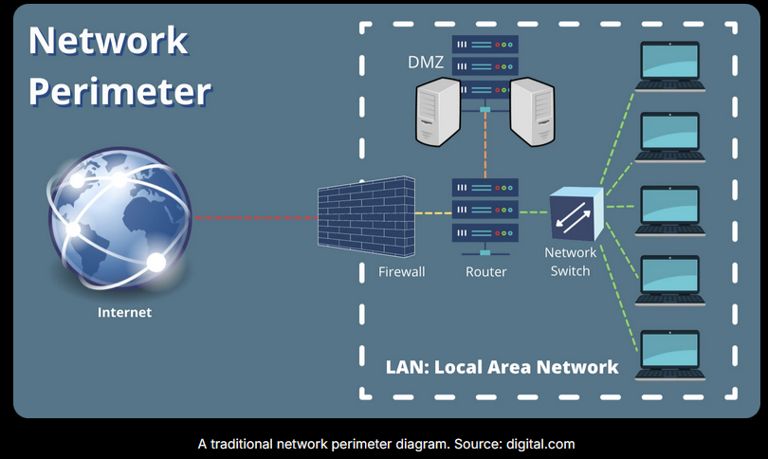
Network Perimeter
A network perimeter is the boundary between an organization's secured internal network and the Internet — or any other uncontrolled external network.

Slide 3
Perimeter Security
It is a practice of securing an organization’s IT and OT infrastructure by establishing protective measures at the outer boundary of its network.
The goal of perimeter defense is to prevent
unauthorized access,
data breaches,
cyber threats from entering the network.
This is traditionally achieved through technologies like
firewalls,
intrusion detection and prevention systems (IDS/IPS)

Slide 4
Intrusion
A network intrusion is an unauthorized penetration of a computer in your enterprise or an address in your assigned domain.
An intrusion can be passive (in which penetration is gained stealthily and without detection) or active (in which changes to network resources are effected).

Slide 5
Security Attack
Any action that compromises the security of information owned by an organization
Information security is about how to prevent attacks, or failing that, to detect attacks on information-based systems
Often threat & attack used to mean same thing
Have a wide range of attacks
Can focus of generic types of attacks
passive
active
Notes:
Expand on definition and use of “security attack”, as detailed above.
See Stallings Table 1.1 for definitions of threat and attack.

Slide 6
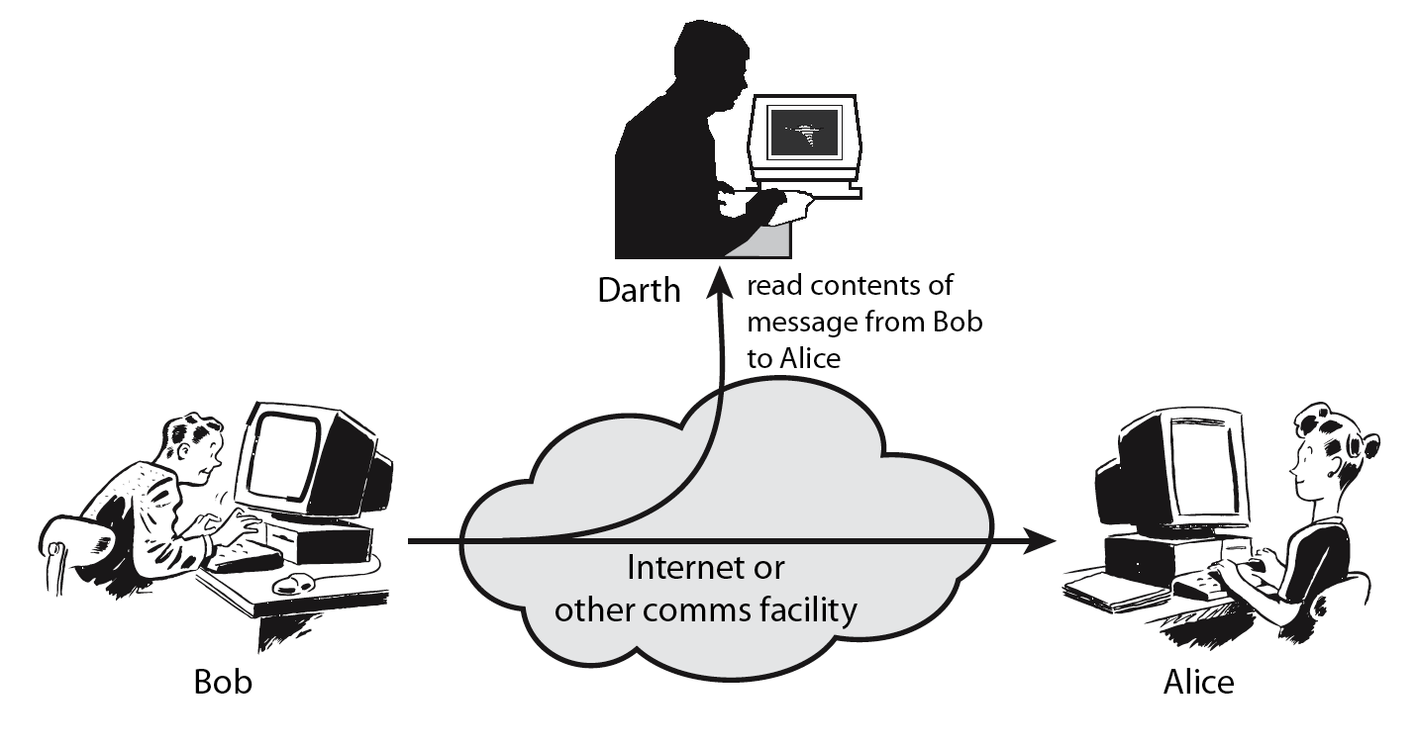
Passive Attacks
Notes:
Have “passive attacks” which attempt to learn or make use of information from the system but does not affect system resources.
By eavesdropping on, or monitoring of, transmissions to:
+ obtain message contents (as shown above in Stallings Figure 1.3a), or
+ monitor traffic flows
Are difficult to detect because they do not involve any alteration of the data.

Slide 7
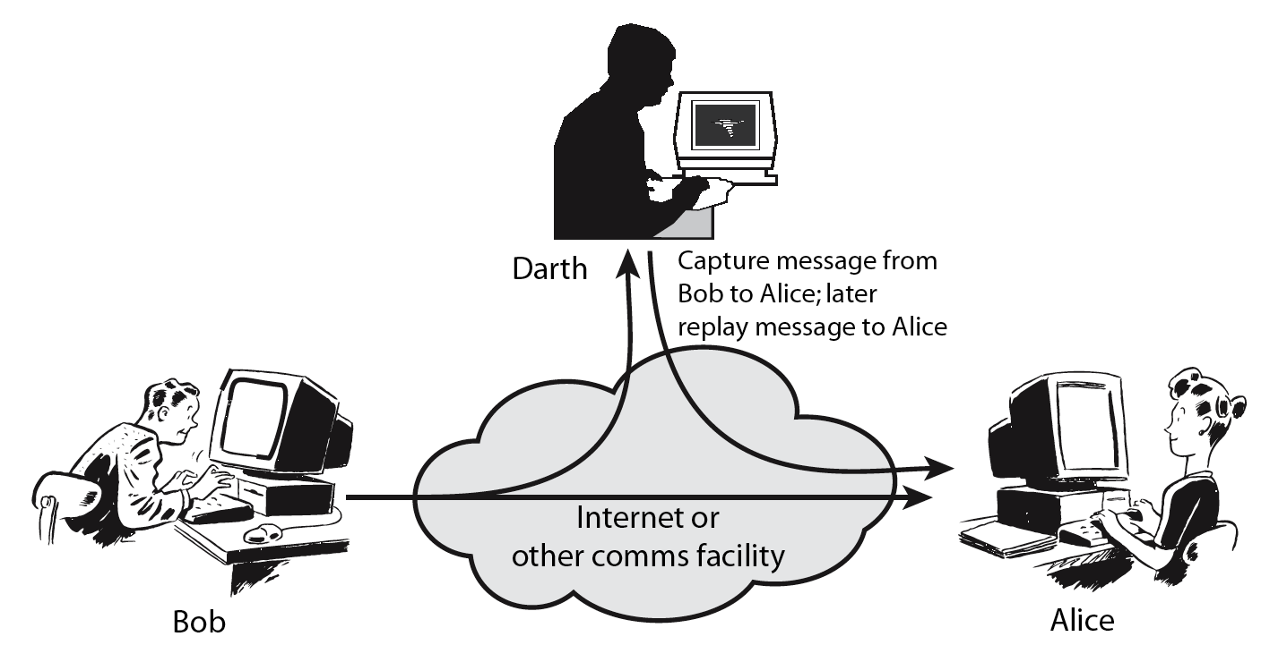
Active Attacks
Notes:
Also have “active attacks” which attempt to alter system resources or affect their operation.
By modification of data stream to:
+ masquerade of one entity as some other
+ replay previous messages (as shown above in Stallings Figure 1.4b)
+ modify messages in transit
+ denial of service
Active attacks present the opposite characteristics of passive attacks. Whereas passive attacks are difficult to detect, measures are available to prevent their success. On the other hand, it is quite difficult to prevent active attacks absolutely, because of the wide variety of potential physical,software,and network vulnerabilities. Instead, the goal is to detect active attacks and to recover from any disruption or delays caused by them.

Slide 8
Risk of Intrusion
Corruption of Data
Theft of Data
Loss of Reputation
Non-Availability

Slide 9
Intrusion Steps
Reconnaissance – Ports that are open, identify the operating system
Initial Exploitation – Brute force to access the SSH
Maintain Persistence – Install Tools/Agents

Slide 10
Detection Mechanisms
Intrusion Detection or Prevention Mechanism
Firewall

Slide 11
Intrusion Detection System
IDS (Intrusion Detection System) monitors networks for suspicious and malicious activities, as well as false alarms.
Distinguish between normal network traffic and malicious activities.
Types
Host Based
Network Based

Slide 12
Detection Method
Signature-based Detection
Anomaly Based Detection
Static Analysis
Dynamic Analysis - Sandbox
Behaviour Analysis

Slide 13
Indicators
Rate of flow of packets.
Repetition of the packets.

